Slide 1
Metacognition is not enough: Promoting self regulated learning in your class
Dr. Ted Clark
Department of Chemistry and Biochemistry
The Ohio State University

Slide 2
Context
Greater emphasis is now being given to improving students’ knowledge of science content by allocating more attention to metacognition, epistemology, and student beliefs and attitudes (Seethaler, 2015).
Seethaler, S. (2015). Five Things Chemists (and Other Science Faculty) Should Know about the Education Research Literature. Journal of Chemical Education, 93(1), 9-12.

Slide 3
Context
Greater emphasis is now being given to improving students’ knowledge of science content by allocating more attention to metacognition, epistemology, and student beliefs and attitudes (Seethaler, 2015).

Slide 4
Context
Greater emphasis is now being given to improving students’ knowledge of science content by allocating more attention to metacognition, epistemology, and student beliefs and attitudes (Seethaler, 2015).
More than 50 presentations discussed student metacognition.

Slide 5
Context
Greater emphasis is now being given to improving students’ knowledge of science content by allocating more attention to metacognition, epistemology, and student beliefs and attitudes (Seethaler, 2015).
The Learner…
Metacognitive knowledge.
Differentiate between concepts mastered and those requiring further study.
Understand strategies for learning.
Knows how, and when, to use different strategies.

Slide 6
Context
Greater emphasis is now being given to improving students’ knowledge of science content by allocating more attention to metacognition, epistemology, and student beliefs and attitudes (Seethaler, 2015).
The Learner…
Metacognitive knowledge.
Differentiate between concepts mastered and those requiring further study.
Understand strategies for learning.
Knows how, and when, to use different strategies.
Motivation
Behavior

Slide 7
Context
Greater emphasis is now being given to improving students’ knowledge of science content by allocating more attention to metacognition, epistemology, and student beliefs and attitudes (Seethaler, 2015).
The Learner…
Metacognitive knowledge.
Differentiate between concepts mastered and those requiring further study.
Understand strategies for learning.
Knows how, and when, to use different strategies.
Motivation
Has high self-efficacy and is interested in learning.
Learns autonomously, has self-accountability.
Behavior
Optimizes study environment.
Employs appropriate learning strategies, and adjusts approach as needed, based on feedback.

Slide 8
Context
Greater emphasis is now being given to improving students’ knowledge of science content by allocating more attention to metacognition, epistemology, and student beliefs and attitudes (Seethaler, 2015).
The Learner…
Metacognitive knowledge.
Differentiate between concepts mastered and those requiring further study.
Understand strategies for learning.
Knows how, and when, to use different strategies.
Motivation
Has high self-efficacy and is interested in learning.
Learns autonomously, has self-accountability.
Behavior
Optimizes study environment.
Employs appropriate learning strategies, and adjusts approach as needed, based on feedback.
Self-Regulated Learning
In response to metacognitive awareness of a gap between performance and goals, and driven by self-efficacy and the will to improve, the learner implements intentional changes in learning strategies.
Notes:
From Sebesta

Slide 9
Context
Greater emphasis is now being given to improving students’ knowledge of science content by allocating more attention to metacognition, epistemology, and student beliefs and attitudes (Seethaler, 2015).
The Learner…
Metacognitive knowledge.
Differentiate between concepts mastered and those requiring further study.
Understand strategies for learning.
Knows how, and when, to use different strategies.
Motivation
Has high self-efficacy and is interested in learning.
Learns autonomously, has self-accountability.
Behavior
Optimizes study environment.
Employs appropriate learning strategies, and adjusts approach as needed, based on feedback.
Self-Regulated Learning
In response to metacognitive awareness of a gap between performance and goals, and driven by self-efficacy and the will to improve, the learner implements intentional changes in learning strategies.
Feedback
Action
Strategies

Slide 10
Metacognitive Knowledge
Add metacognition to existing course elements
Practice tests & score prediction (Casselman & Atwood)
Practice tests & mental effort (Holme)
Enhanced answers keys & reflection (Sabel)
Add new course elements
Videos, e.g. “How to Get the Most out of Studying” (used by Cardinale)
Surveys of metacognitive strategies
(Stanton; Sebesta; Bunce); M-ASSISST (Bunce)

Slide 11
Metacognitive Knowledge
Add metacognition to existing course elements
Practice tests & score prediction (Casselman & Atwood)
Practice tests & mental effort (Holme)
Enhanced answers keys & reflection (Sabel)
Add new course elements
Videos, e.g. “How to Get the Most out of Studying” (used by Cardinale)
Surveys of metacognitive strategies
(Stanton; Sebesta; Bunce); M-ASSISST (Bunce)
Casselman, B. L., & Atwood, C. H. (2017). Improving general chemistry course performance through online homework-based metacognitive training. Journal of Chemical Education, 94(12), 1811-1821.
Sabel, J. L., Dauer, J. T., & Forbes, C. T. (2017). Introductory Biology Students’ Use of Enhanced Answer Keys and Reflection Questions to Engage in Metacognition and Enhance Understanding. CBE—Life Sciences Education, 16(3), ar40.

Slide 12
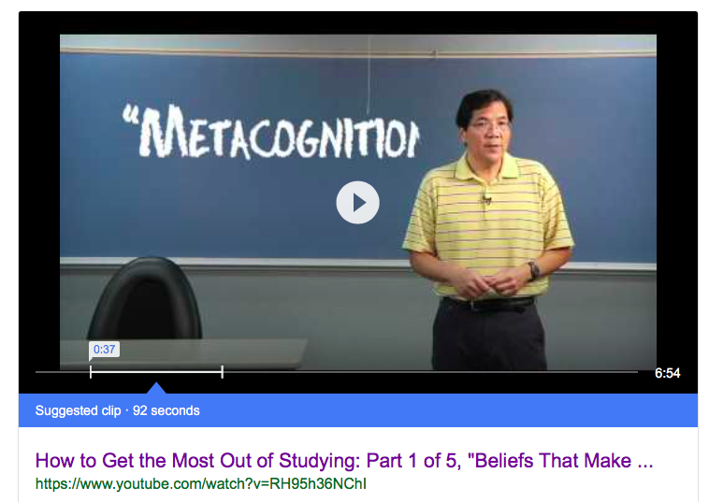
Metacognitive Knowledge
Add metacognition to existing course elements
Practice tests & score prediction (Casselman & Atwood)
Practice tests & mental effort (Holme)
Enhanced answers keys & reflection (Sabel)
Add new course elements
Videos, e.g. “How to Get the Most out of Studying” (used by Cardinale)
Surveys of metacognitive strategies
(Stanton; Sebesta; Bunce); M-ASSISST (Bunce)

Slide 13
Metacognitive Knowledge
Add metacognition to existing course elements
Practice tests & score prediction (Casselman & Atwood)
Practice tests & mental effort (Holme)
Enhanced answers keys & reflection (Sabel)
Add new course elements
Videos, e.g. “How to Get the Most out of Studying” (used by Cardinale)
Surveys of metacognitive strategies
(Stanton; Sebesta; Bunce); M-ASSISST (Bunce)
Sebesta, A. J., & Bray Speth, E. (2017). How Should I Study for the Exam? Self-Regulated Learning Strategies and Achievement in Introductory Biology. CBE—Life Sciences Education, 16(2), ar30.

Slide 14
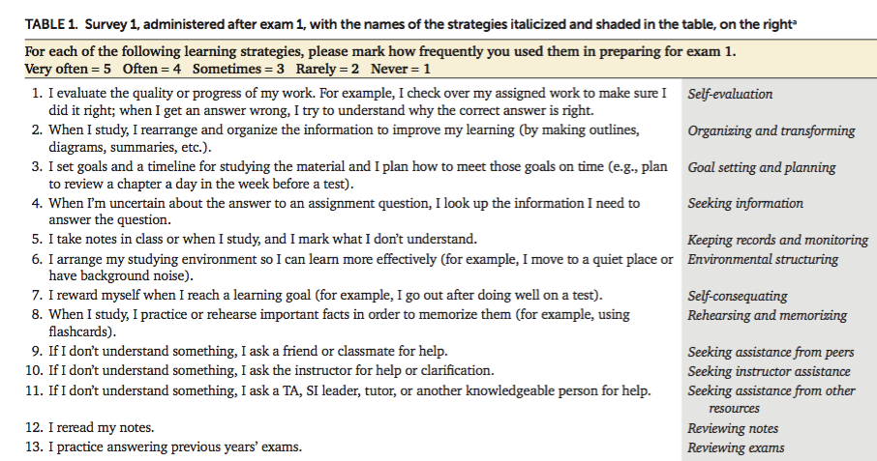

Slide 15
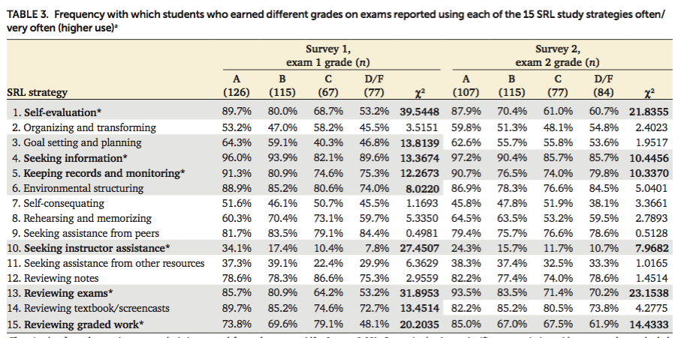

Slide 16
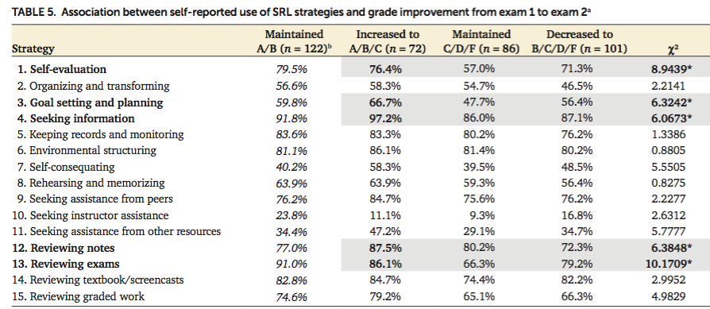

Slide 17
Metacognitive Knowledge
Add metacognition to existing course elements
Practice tests & score prediction (Casselman & Atwood)
Practice tests & mental effort (Holme)
Enhanced answers keys & reflection (Sabel)
Add new course elements
Videos, e.g. “How to Get the Most out of Studying” (used by Cardinale)
Surveys of metacognitive strategies
(Stanton; Sebesta; Bunce); M-ASSISST (Bunce)
Bunce, D. M., Komperda, R., Schroeder, M. J., Dillner, D. K., Lin, S., Teichert, M. A., & Hartman, J. R. (2017). Differential use of study approaches by students of different achievement levels. Journal of Chemical Education, 94(10), 1415-1424.

Slide 18
Metacognitive Knowledge
Add metacognition to existing course elements
Practice tests & score prediction (Casselman & Atwood)
Practice tests & mental effort (Holme)
Enhanced answers keys & reflection (Sabel)
Add new course elements
Videos, e.g. “How to Get the Most out of Studying” (used by Cardinale)
Surveys of metacognitive strategies
(Stanton; Sebesta; Bunce); M-ASSISST (Bunce)
Successful, improving students Less successful, declining students
Use specific strategies Fail to implement plan
Deep, meaningful strategies Surface, superficial strategies
Favor independent resources, Seek personal help,
like practice tests. like tutors
Bunce, D. M., Komperda, R., Schroeder, M. J., Dillner, D. K., Lin, S., Teichert, M. A., & Hartman, J. R. (2017). Differential use of study approaches by students of different achievement levels. Journal of Chemical Education, 94(10), 1415-1424.

Slide 19
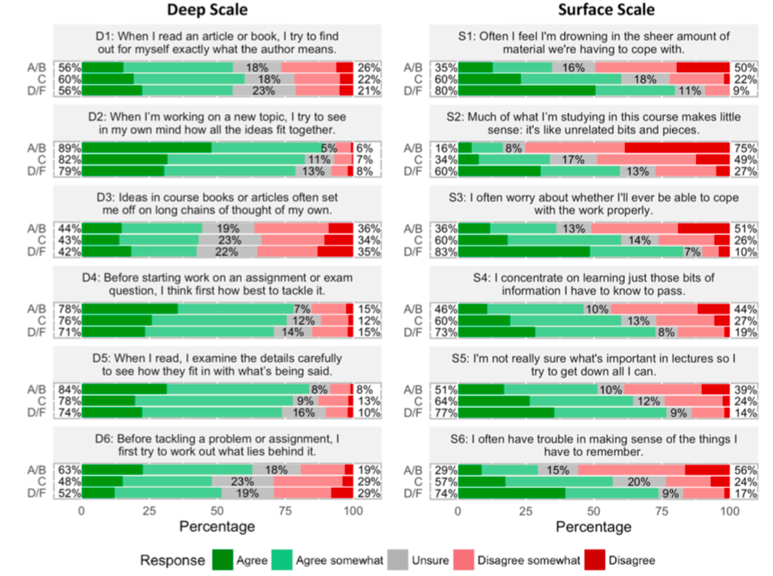

Slide 20
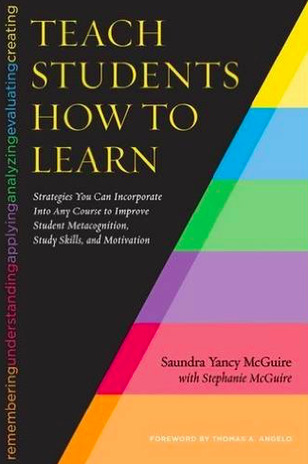
McGuire’s Approach
Improve student metacognitive knowledge and convince them to adopt a growth mindset and employ evidence based learning strategies.
Use an in-class presentation to demonstrate how learning strategies that “worked” in high school are not sufficient in college.

Slide 21
McGuire’s Approach
Improve student metacognitive knowledge and convince them to adopt a growth mindset and employ evidence based learning strategies.
Use an in-class presentation to demonstrate how learning strategies that “worked” in high school are not sufficient in college.
“I can’t believe how poorly I did on the midterm. I never struggled on a test in high school, and this exam crushed me. I didn’t even recognize many of the questions. I am lost and don’t know what to do next. This makes me think I am just not good at Chemistry.”
-- Many freshmen in my office hours

Slide 22
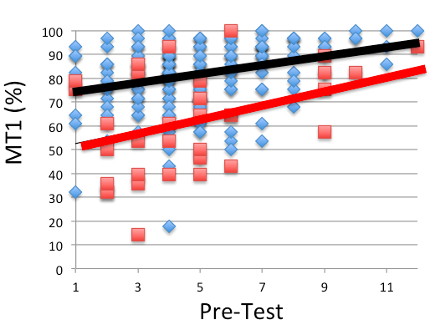
You Can Become a Better Learner

Slide 23
This pyramid depicts the different levels of thinking we use when learning. Each level builds on the foundation that precedes it. We must learn the lower levels before we can effectively use the skills above.
Bloom’s Taxonomy
Evaluation
Making decisions and supporting views; requires understanding of values.
Graduate School
Synthesis
Combining information to form a unique product; requires creativity and originality.
Identifying components; determining arrangement, logic, and semantics.
Analysis
Undergraduate
Using information to solve problems; transferring abstract or theoretical ideas to practical situations. Identifying connections and relationships and how they apply.
Application
Restating in your own words; paraphrasing, summarizing, translating.
Comprehension
High School
Memorizing verbatim information. Being able to remember, but not necessarily fully understanding the material.
Knowledge
Louisiana State University  Center for Academic Success  B-31 Coates Hall  225-578-2872  www.cas.lsu.edu

Slide 24
Post-class homework that includes earlier material, prompting recall of information.
Pre-class questions as homework
Frequent in-class questions & discussions
Multiple timed practice exams with feedback
Active reading, Take notes,
Sample problems.
Work with classmates, write and share exam questions.
Treat class as a
self-test.
Address weaknesses
Reach mastery.
Teach the material.
Best
Mental Review. Coordinate class
notes & book.
Review first, then use homework a self-test
Consolidate and review notes.
Use practice test as self-test.
Better
Active reading
Use practice tests to identify objectives, learn from mistakes
Good
Preview and map material
Identify Objectives
& Problem-solving strategies
Identify and learn from mistakes
Complete homework
(the last day)
Read class slides, Look at homework problems.
Typical
Nothing
Attend every class
Before Class Class After Class Preparing for Exams
The Class Format Can Support the Best Practices

Slide 25
In-Class Survey & After Intervention.
“I think the information on metacognitive learning strategies will help me learn in this class.” 99% strongly agree or agree.

Slide 26
In-Class Survey & After Intervention.
“I think the information on metacognitive learning strategies will help me learn in this class.” 99% strongly agree or agree.
“This is the only class that has encouraged me to strive to be the best I can be. No other professor or TA has ever told me that I can do well in their class. This is also the only class that has given ‘study’ tips.”

Slide 27
In-Class Survey & After Intervention.
“I think the information on metacognitive learning strategies will help me learn in this class.” 99% strongly agree or agree.
“This is the only class that has encouraged me to strive to be the best I can be. No other professor or TA has ever told me that I can do well in their class. This is also the only class that has given ‘study’ tips.”
N
The intervention leads to a growth mindset and the intention to use metacognitive learning strategies before, in, and after class.

Slide 28
“To succeed in this class I need to study differently than I did in High School.”

Slide 29
“To succeed in this class I need to study differently than I did in High School.”
Strongly Disagree

Slide 30
Open-Response Prompt
As we reach the end of the semester, your approach for learning and studying General Chemistry has probably settled into a routine.
Describe your practices in four paragraphs. In each paragraph, describe 1) what you do, 2) how/if you changed during the semester, and 3) how the class can be structured to better address your learning in this area.
Before class learning.
In-Class.
After class/homework.
Exam preparation.

Slide 31
Open-Response Prompt
As we reach the end of the semester, your approach for learning and studying General Chemistry has probably settled into a routine.
Describe your practices in four paragraphs. In each paragraph, describe 1) what you do, 2) how/if you changed during the semester, and 3) how the class can be structured to better address your learning in this area.
Before class learning.
In-Class.
After class/homework.
Exam preparation.
Course Structure & Practices
Textbook & active reading,
pre-class homework.
Note taking by hand, group discussion, identify problem-solving strategies.
Recall/review info., return to textbook, consolidate info., HW as a self-test.
Summarize info., authentic use of practice tests, address weaknesses, teach the material.

Slide 32
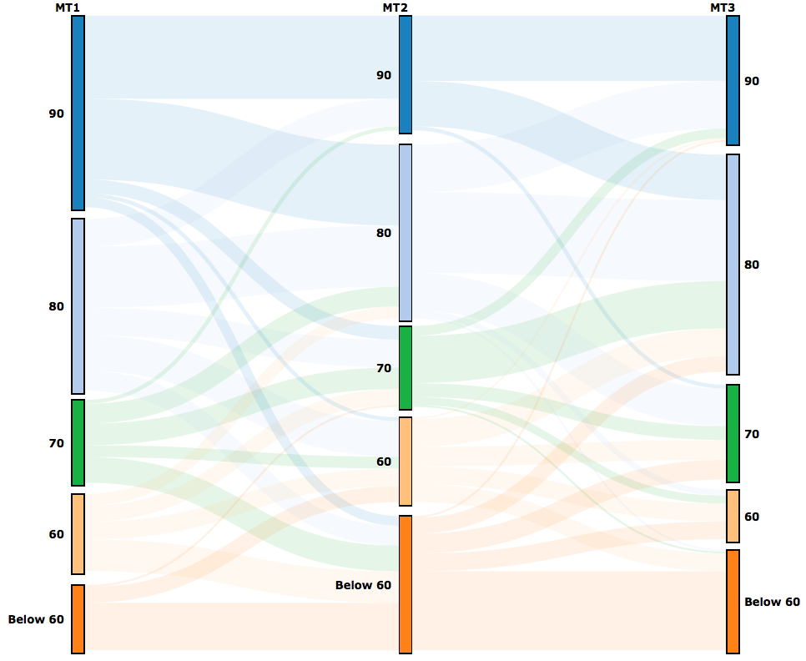
Metacognition Intervention
Initial Survey
Avg. 72
Avg. 78
Avg. 75

Slide 33
Metacognition Intervention
Initial Survey
Avg. 72
Avg. 75

Slide 34
Metacognition Intervention
Initial Survey

Slide 35
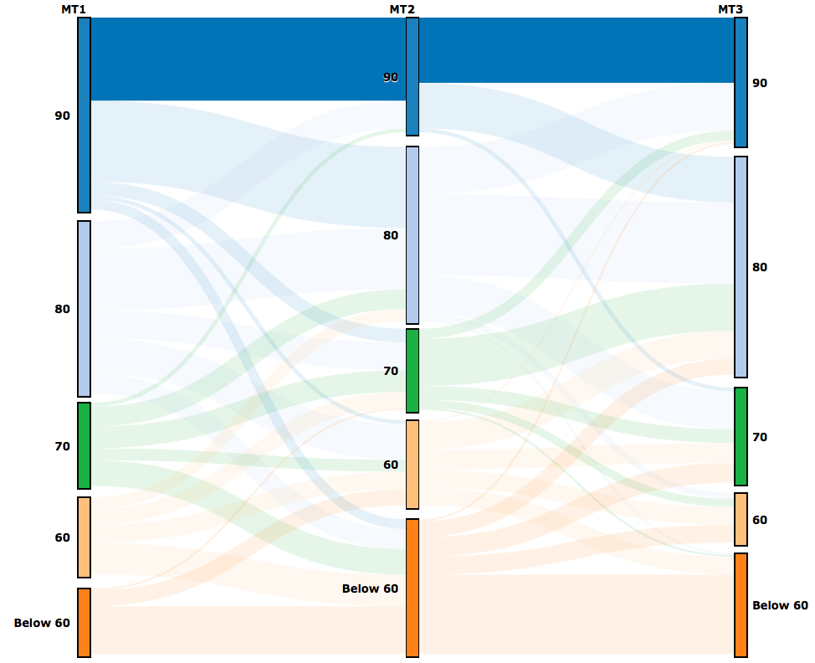
Metacognition Intervention
Initial Survey

Slide 36
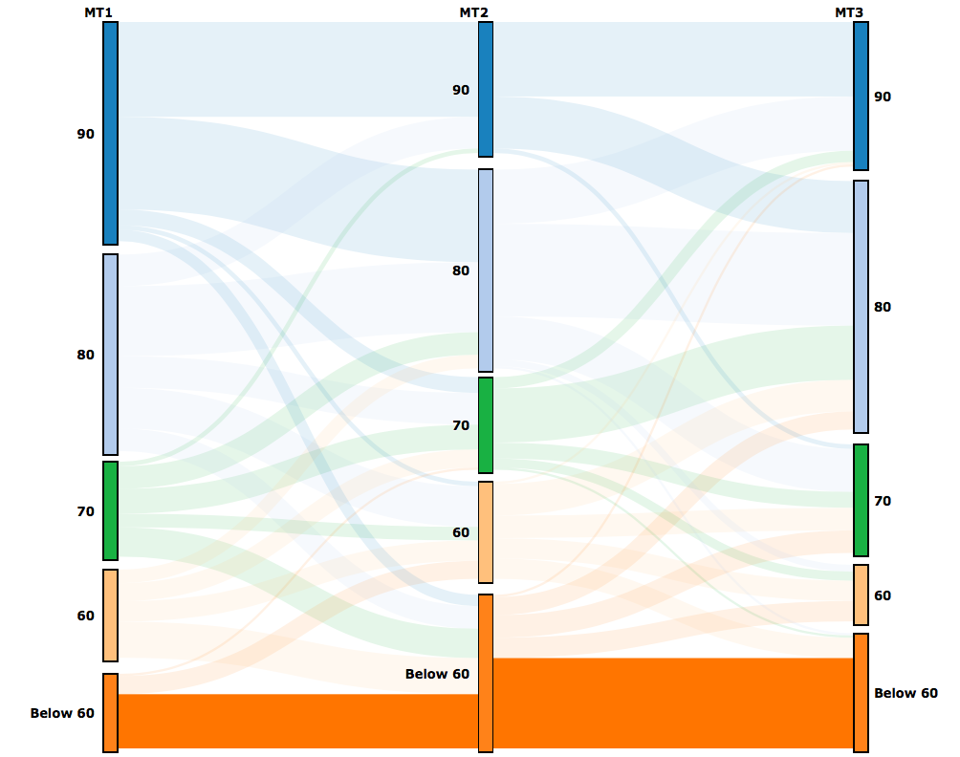
Metacognition Intervention
Initial Survey

Slide 37
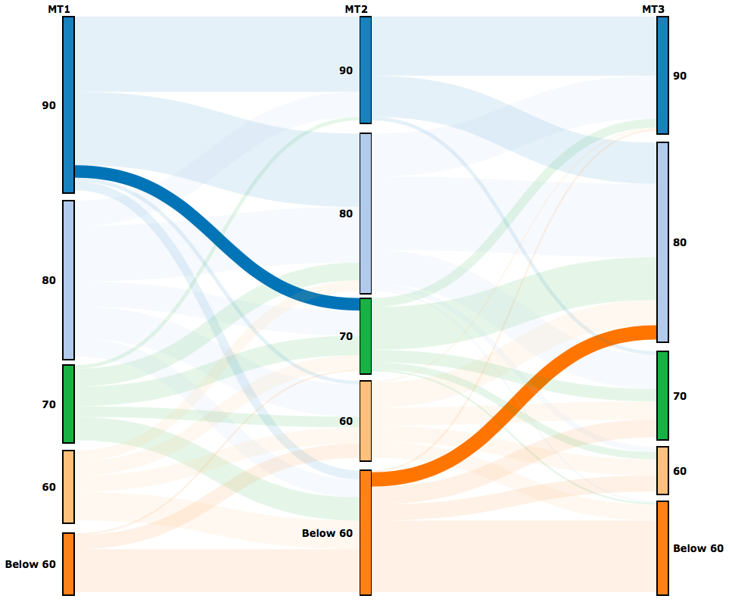
Metacognition Intervention
Initial Survey

Slide 38
Always strong
Bounce Back
Average MT (%)
Decline
Always weak
Feedback
Action
Strategies

Slide 39
Pre-Class Learning Strategy
Percent
Average MT (%)

Slide 40
Pre-Class Learning Strategy
Percent
Changing Strategy
Average MT (%)
% Changing

Slide 41
Pre-Class Learning Strategy
“At the beginning of the year I would never read or prepare before class, this was mainly because I had already taken AP Chemistry. This made me think that I already knew what I was learning. That turned out not to be the complete truth…
After the first exam when I got an A, my pre-class preparation sunk even lower as I thought that I did not even need to look at the material to do good in the class.
After I didn’t do too well on the second midterm, I started reading the chapter and doing practice problems before the material was discussed in class.
This greatly improved my understanding on the material and using the suggested before-class study skills helped me get a much better grade on my third midterm.”
Percent
Changing Strategy
% Changing

Slide 42
Pre-Class Learning
Feedback
Deeper leaning strategies were used by the more successful students.
Action
Strategies

Slide 43
Pre-Class Learning
Bounce Back: Initially poor metacognition, reinforced by early success.
Strong performers: Changed strategies as needed.
“I seemed behind in the lecture”
Feedback
Deeper leaning strategies were used by the more successful students.
Action
Strategies

Slide 44
Pre-Class Learning
Bounce Back: Initially poor metacognition, reinforced by early success.
Strong performers: Changed strategies as needed.
“I seemed behind in the lecture”
Feedback
Deeper leaning strategies were used by the more successful students.
Action
Strategies

Slide 45
Pre-Class Learning
Bounce Back: Initially poor metacognition, reinforced by early success.
Strong performers: Changed strategies as needed.
“I seemed behind in the lecture”
Feedback
Deeper leaning strategies were used by the more successful students.
Action
Strategies
Average MT (%)

Slide 46
“At the beginning of the year I would never read or prepare before class, this was mainly because I had already taken AP Chemistry. This made me think that I already knew what I was learning. That turned out not to be the complete truth…
After the first exam when I got an A, my pre-class preparation sunk even lower as I thought that I did not even need to look at the material to do good in the class.
After I didn’t do too well on the second midterm, I started reading the chapter and doing practice problems before the material was discussed in class.
This greatly improved my understanding on the material and using the suggested before-class study skills helped me get a much better grade on my third midterm.”
Average MT (%)

Slide 47
Pre-Class Learning
Bounce Back: Initially poor metacognition, reinforced by early success.
.
Strong performers: Changed strategies as needed.
“I seemed behind in the lecture”
Feedback
Deeper leaning strategies were used by the more successful students.
Action
Strategies
“I felt overwhelmed when I read the textbook without an idea or explanation from lecture.”
“I became less sure of what to write down”
“No time (to do more)”
“If I could go back in time, instead of just reading the slides, I would have also read the actual chapter and summarize each section.”

Slide 48
Pre-Class Learning
Bounce Back: Initially poor metacognition, reinforced by early success.
Strong performers: Changed strategies as needed.
“I seemed behind in the lecture”
Feedback
Deeper leaning strategies were used by the more successful students.
Action
Strategies
“I felt overwhelmed when I read the textbook without an idea or explanation from lecture.”
“I became less sure of what to write down”
“No time (to do more)”
“If I could go back in time, instead of just reading the slides, I would have also read the actual chapter and summarize each section.”
There are many ways to support the reading of a textbook.

Slide 49
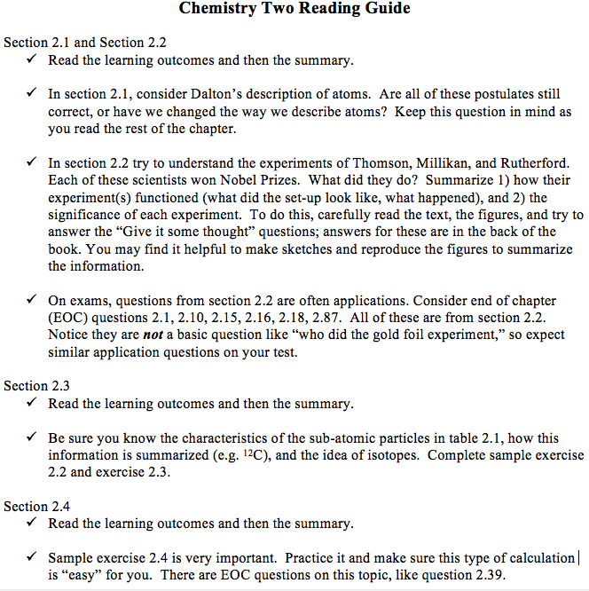

Slide 53
Before class…I just skim the material within the textbook. There is no need for me to intensely study the material before I come to class as I have a tutor. I feel as though the class is too rushed, and I hate the notion set in place by the chemistry department that we should be masters of material that most have never seen before we even step into class. I feel the class needs to be oriented towards thoroughly leaning the material (in the classroom) rather than outside the classroom as most students cannot teach themselves the material. I know I cannot. (In the classroom) The class needs to be slowed down significantly and go in more depth for me to understand it. I got a tutor around half way through the semester, as I tried teaching myself and it did not work out.

Slide 54
In-Class, Post-Class
Percent
Average MT (%)

Slide 55
In-Class, Post-Class
X
Percent
X
Average MT (%)

Slide 56
In-Class, Post-Class
X
X
Percent
X
X
Average MT (%)

Slide 57
In-Class, Post-Class
X
X
X
Percent
X
X
Average MT (%)

Slide 58
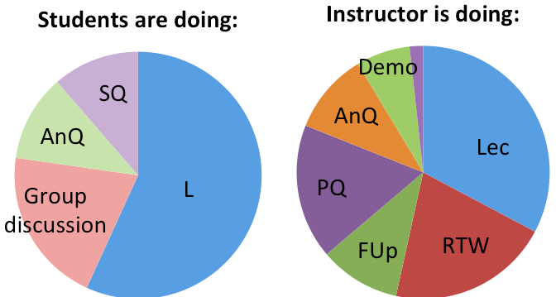
In-Class, Post-Class
X
X
X
Percent
X
X
Average MT (%)

Slide 59
Exam Prep.
Percent

Slide 60
Exam Prep.
Percent
“I only used class slides and notes. I thought this would be enough.” Decline
“I return to note packets, then make an important ideas sheet, then return to the important ideas/possible exam question lists I wrote down (after each class) and make sure all of those points are addressed on the important concept page. I then begin taking practice tests and go over with a friend the answers and we explain the ones we get wrong to each other. The night before the exam we go to a whiteboard and we rotate teaching different sections.” Strong
“Cramming, not actually learning. If I could go back and do it again I would actually try to study for awhile before the exam.” Decline

Slide 61
Exam preparation checklist:
List of resources, tasks, etc.
Perhaps as an assignment.
Percent
“I only used class slides and notes. I thought this would be enough.” Decline
“I return to note packets, then make an important ideas sheet, then return to the important ideas/possible exam question lists I wrote down (after each class) and make sure all of those points are addressed on the important concept page. I then begin taking practice tests and go over with a friend the answers and we explain the ones we get wrong to each other. The night before the exam we go to a whiteboard and we rotate teaching different sections.” Strong
“Cramming, not actually learning. If I could go back and do it again I would actually try to study for awhile before the exam.” Decline

Slide 62
Practice exams placed within the homework system, due a few days before the actual test.
Percent
“I only used class slides and notes. I thought this would be enough.” Decline
“I return to note packets, then make an important ideas sheet, then return to the important ideas/possible exam question lists I wrote down (after each class) and make sure all of those points are addressed on the important concept page. I then begin taking practice tests and go over with a friend the answers and we explain the ones we get wrong to each other. The night before the exam we go to a whiteboard and we rotate teaching different sections.” Strong
“Cramming, not actually learning. If I could go back and do it again I would actually try to study for awhile before the exam.” Decline

Slide 63
Before class I contemplate not going. I never study or look over information beforehand. Perhaps this contributes to my below average grade. I only looked over information before lecture a few times, and I did not succeed in teaching myself the information, so I closed the tab and did other things. Always weak

Slide 64
Before class I contemplate not going. I never study or look over information beforehand. Perhaps this contributes to my below average grade. I only looked over information before lecture a few times, and I did not succeed in teaching myself the information, so I closed the tab and did other things. Always weak
Metacognitive knowledge
Motivation
Behavior
Feedback
Action
Strategies

Slide 65
After the first exam
Identify development: foreclosed (n=2) & achievement (n=2)
Mindset: growth & fixed (n=8)
Perfectionism: parental expectation (n=5)
Social goals: social concern (n=6) & responsibility (n=6)
Belonging in STEM (n=18)
Belonging in this class (n=18)
Instructor support (n=6)
Course organization (n=9)
Academic pressure (n=8)
Individualized classroom environment (n=5)
Peer climate (n=6)
Social comparison concern (n=6)
Comfort being oneself in a group (n=4)
Classroom goal structure: mastery (n=4) & performance approach (n=2) & avoidance (n=2)
Chemistry personal goal: mastery (n=3) & performance approach (n=3) & avoidance (n=3)
Triggered situational interest (n=8)
Active procrastination: Outcome satisfaction (n=4), pressure (n=4), intentional (n=4), ability to meet deadlines (n=4), procrastination, general (n=5).
Metacognitive strategies: rehearsal (n=4), elaboration, (n=6), organization (n=4), critical thinking (n=5).
Notes:
About 175 questions

Slide 66
End of the semester
Metacognitive strategies: rehearsal (n=4), elaboration, (n=6), organization (n=4), critical thinking (n=5).
Brief regulation of motivation (n=10).
Help seeking from peers: adaptive (n=4) & expedient (n=4).
Help giving: little hint (n=5), big hint (n=4), give answer (n=4), no help (n=4).
Engagement: choice (n= 4), effort (n=4), persistence (n=4)
Interactive learning (n=5)
Maintained situational interest: hold (n=8)
Chemistry perceived task (n=4)
Chemistry value (n=7), values 2 (n=9)
Perceived cost: task (n=5), outside effort (n=4), loss of valued alternative (n=4), emotional cost (n=6)
Self-efficacy: class (n=5), domain (n=5)
Individual interest (n=8)
Intent to drop STEM and other educational goals (n=26)
Notes:
Also about 175 questions

Slide 67
Nearly Every Scale is Strongly Correlated with Achievement
High Achieving Students Low Achieving Students
Comfort Being Oneself in Group
I feel like it’s okay to make mistakes in front of others in this chemistry class.
I feel like it’s okay to ask ‘dumb’ questions in this chemistry class.
Social Comparison
I often leave this chemistry class feeling like I am not as smart as others.
I often feel intimidated to participate in this chemistry class.
Brief Regulation of Motivation Scale
It’s easy for me to make myself study for this chemistry class, even if I would rather be doing something else.
Engagement and Choice
I won’t take another chemistry class unless it is required.
I plan to avoid taking any more classes that involve doing chemistry.
Maintained Situational Interest
This chemistry class fascinates me.
I think what we are studying in this class is useful for me to know.
Self-Efficacy
I can do almost all the work in this class if I don’t give up.
Situational Interest
To be honest, I just don’t find this class to be very interesting.
Perceived Difficulty
Compared to the other courses I am taking, this class is very difficult.
Perceived Cost
I have to sacrifice too much to be in this class.

Slide 68
Not Correlated with Achievement in this Class
Mindset, growth vs. fixed
You have a certain amount of intelligence, and you can’t do much to change it.
Identify Development (Foreclosed)
My parents decided a long time ago what I should pursue for a major and I’m following through their plans.
Perfectionism (Parental Expectation)
My parents expect excellence for me in my STEM field.
Social Concern
I try to do well in my STEM field so I can help my classmates.
Bennion, L. D., & Adams, G. R. (1986). A revision of the extended version of the Objective Measure of Ego Identity Status: An identity instrument for use with late adolescents. Journal of adolescent research, 1(2), 183-197.
Frost, R. O., Marten, P., Lahart, C., & Rosenblate, R. (1990). The dimensions of perfectionism. Cognitive therapy and research, 14(5), 449-468.
Dowson, M., & McInerney, D. M. (2004). The development and validation of the Goal Orientation and Learning Strategies Survey (GOALS-S). Educational and psychological measurement, 64(2), 290-310.

