Slide 1
Asynchronous Flipped Gameful Mastery Learning
by Jonathan Thomas-Palmer
Notes:
To do / have ready for the 4T2014 Webinar:
Resize screen to normal size.
Google Analytics, Google Drive, Weebly & WatchKnowLearn open in Safari
Turn off notifications
Turn off screen saver
Turn off Energy Saver
Turn off noisy things in the house
pause backblaze
Survey starts with A-E
Use kate’s computer
Screen capture both computers (start 15 minute early)
External Microphones (start 15 minutes early)
External Video Camera, use miniDV and start 1 minute before.
Turn off mic when I am not speaking!

Slide 2
Flipped Learning 2.0
Flipped learning transforms the classroom experience.
How?
edX MOOC - Massive Open Online Course
Professors Barry Fishman and Rachel Niemer

Slide 3
What is Gameful Learning?
gamefulpedagogy.com
Gameful learning is a pedagogical approach that takes inspiration from how good games function, and applies that to the design of learning environments.
Gameful design operates in a self-deterministic framework–we want to apply what self-determination theory says about how intrinsic motivation works to build motivating classroom experiences.

Slide 4
What is Gameful Learning?
gamefulpedagogy.com
Self-determination theory says that in order to feel intrinsically motivated, people need to be able to …
make meaningful choices over what they are doing (autonomy)
be challenged by a task but feel like they can succeed (competency)
feel connected to those around them (belongingness)

Slide 5
School is a game.
What are the
rules of the game?

Slide 6
My Rules
Every student will start out with zero points and will gain points as they do assignments.
All assignments labeled “mandatory” must be completed before taking the quiz to attempt to ascend to the next level.
In order to attain level ascension, each student must earn at least 80% of the points possible on the quiz.
Mastery Learning.
Students will decide at what pace to proceed and when assignments are due.
Asynchronous Learning.

Slide 7
Pause … for questions.

Slide 8
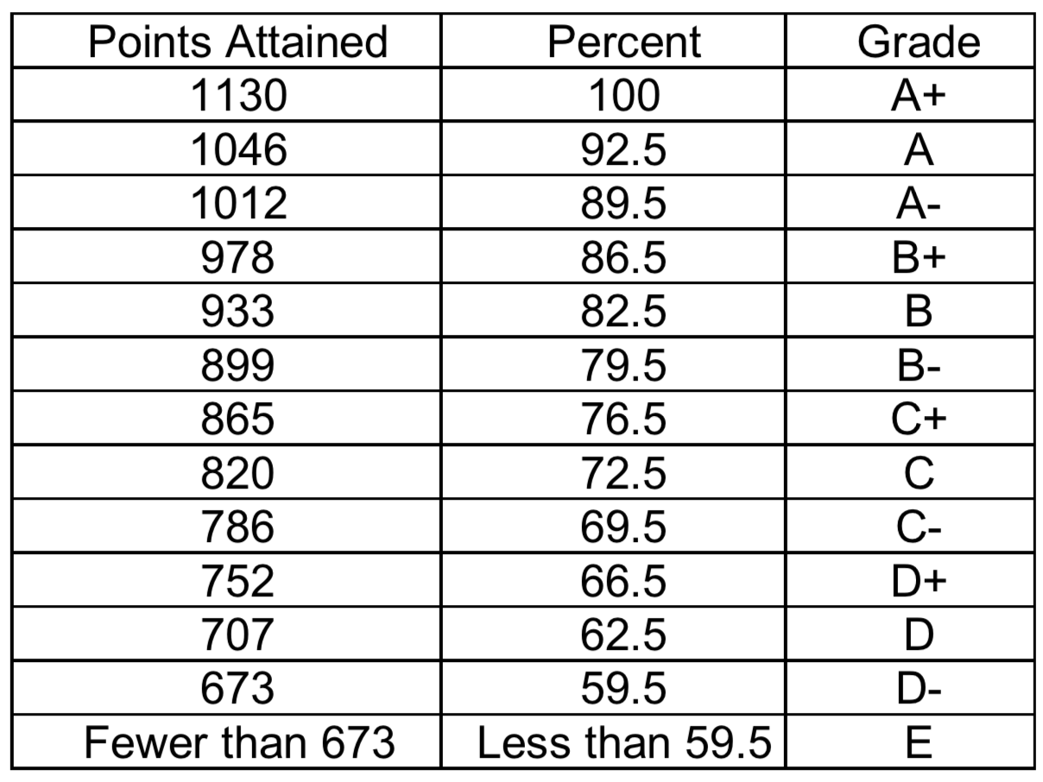
Grading – A point is a point is a point.
100% of all “mandatory” assignment points = 89.5%
This semester 89.5% = 1012 points

Slide 9
Check in on presentation title
Asynchronous Flipped Gameful Mastery Learning

Slide 10
Levels
One Dimensional Motion – The Tutorial Level
Free Fall
Two Dimensional Motion
Relative Motion and Newton
Friction
Friction on Inclines
Work and Energy …

Slide 11
Quizzes
No longer just an assessment of student learning.
Becomes a learning tool.
Quiz corrections.
Mastery learning.
Students decide when they are ready.
Reduces stress and causes fewer freak outs.

Slide 12
What is this actually like?
It’s craziness. (see video)
Does not conform to “normal” teaching.
Does not conform to “normal” teacher evaluations.
Much of the teacher work is beforehand.
Assignments are turned in when the student is ready.
Grading no longer like a breaking dam, it’s at a constant flow rate.
I now only make copies of quizzes/tests.
Laptops / Tablets make this much easier.

Slide 13
What is this actually like?
Efficient with the student’s time.
Easier to be absent or have something else going on in life.
Shakes up lab groups.
So atypical it is refreshing.
Some students actually start class early and/or leave late.
Easier to “make up” assignments when absent.
Current grade is difficult to report.
Current Student Point Totals – Excel Export

Slide 14
Pause … for questions.

Slide 15
What if a student does not finish?
Students have failed.
As hard as I try, sometimes students fail.
Constant check ins with students.
Continuous communication about where they should be in the curriculum.

Slide 16
Any questions about …
Asynchronous
Flipped
Gameful
Mastery
Learning

Slide 17
Thank You!!
www.flippingphysics.com
@flippingphysics
jon@flippingphysics.com
Notes:
To do / have ready for the 4T2014 Webinar:
Resize screen to normal size.
Google Analytics, Google Drive, Weebly & WatchKnowLearn open in Safari
Turn off notifications
Turn off screen saver
Turn off Energy Saver
Turn off noisy things in the house
pause backblaze
Survey starts with A-E
Use kate’s computer
Screen capture both computers (start 15 minute early)
External Microphones (start 15 minutes early)
External Video Camera, use miniDV and start 1 minute before.
Turn off mic when I am not speaking!

